Slide 1
TROJAN MAP
EE 538 - FINAL PROJECT
Notes:
This video is mainly to introduce how to implement a small digital map application. My name is YuanJi Qiu. This is WeiQiang Qian.

Slide 2
OUTLINE
Self-Implementation
Auto Complete Name / Closest name / Find Location
Bellman Ford Shortest Path
Dijsktra Shortest Path
Cycle Detection
Topological Sort
Travelling Salesman Problem
Find Nearby

Slide 3
SELF-IMPLEMENTATION
Notes:
Before getting start it, we developed some of useful tools to help and accelerate our program.

Slide 4
Given names, find their location information.
Using Binary Search !!!
Time: O(logn)
Space: O(n)
<Location Name 1>
<Node Info 1>
<Location Name 2>
<Node Info 2>
<…>
<…>
<Location Name n>
<Node Info n>
Notes:
We notice that lots of function that using location name as its input parameters. However we need to find out its node information instead of the name. We need a fast way to search that.
We use binary search to solve. The time complexity is O(log n).

Slide 5
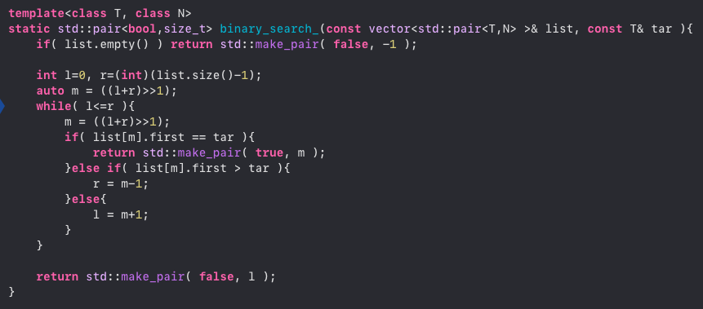
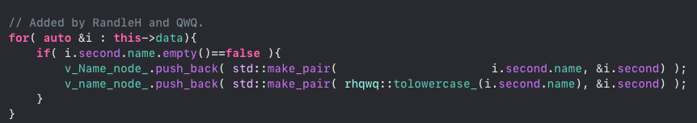
Given names, find their location information.
Using Binary Search !!!
Step 1: Find the node that has a valid name.
Step 2: Sort the array of name first.
Step 3: Apply binary search
Step 4: If the name doesn’t exist, find the nearest one (The one you will insert the name before that).
Notes:
Step 1 is to collect all the location that has a valid name for it.
And next, we sort this array. The sort key is the default string comparison.
Our binary search function will return a pair object that includes the Boolean flag indicating whether the target has been found and the possible alternative that can be.
The second object is the index of the target.

Slide 6
The following functions all used Binary Search !!!
std::string GetID(const std::string& name);
std::vector<std::string> Autocomplete(std::string name);
std::pair<double, double> GetPosition(std::string name);
std::string FindClosestName(std::string name);
std::vector<std::string> CalculateShortestPath_Dijkstra
(std::string location1_name, std::string location2_name);
std::vector<std::string> CalculateShortestPath_Bellman_Ford
(std::string location1_name, std::string location2_name);
std::vector<std::string> FindNearby(std::string attributesName, std::string name, double r, int k);

Slide 7
OUTLINE
Self-Implementation
Auto Complete Name / Closest name / Find Location
Bellman Ford Shortest Path
Dijsktra Shortest Path
Cycle Detection
Topological Sort
Travelling Salesman Problem
Find Nearby

Slide 8
AUTO-COMPLETE & FIND LOCATION

Slide 9

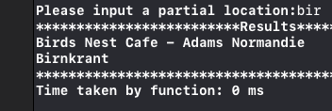
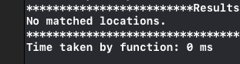
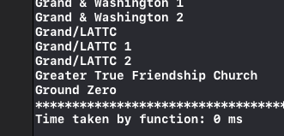
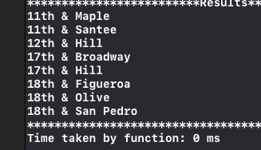
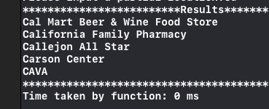
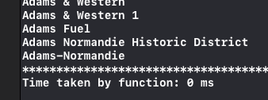
AUTO-COMPLETE
Here are some results for auto-completetion.
Time: O(logn)
Input: ”bir”
Input: ”yu”
Input: ”g”
Input: ”1”
Input: ”Ca”
Input: ”Ada”

Slide 10
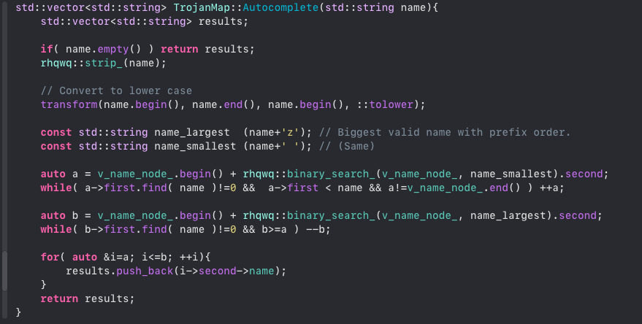
AUTO-COMPLETE

Slide 11
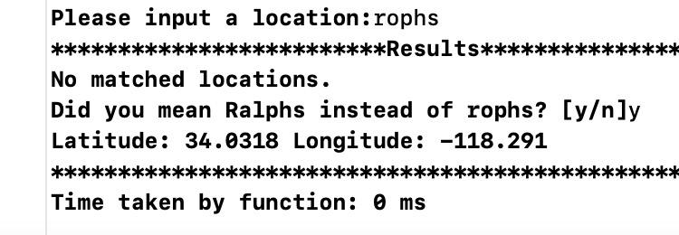
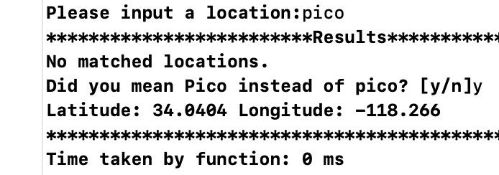
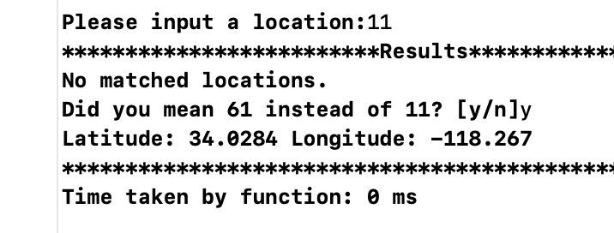
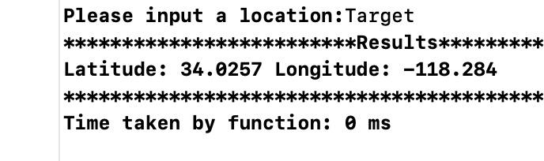
FIND LOCATION
Here are some results for finding a location.
Time: O(logn)
Input: ”rophs”
Input: ”pico”
wrong name
process
Input: ”11”
Input: ”Target”

Slide 12
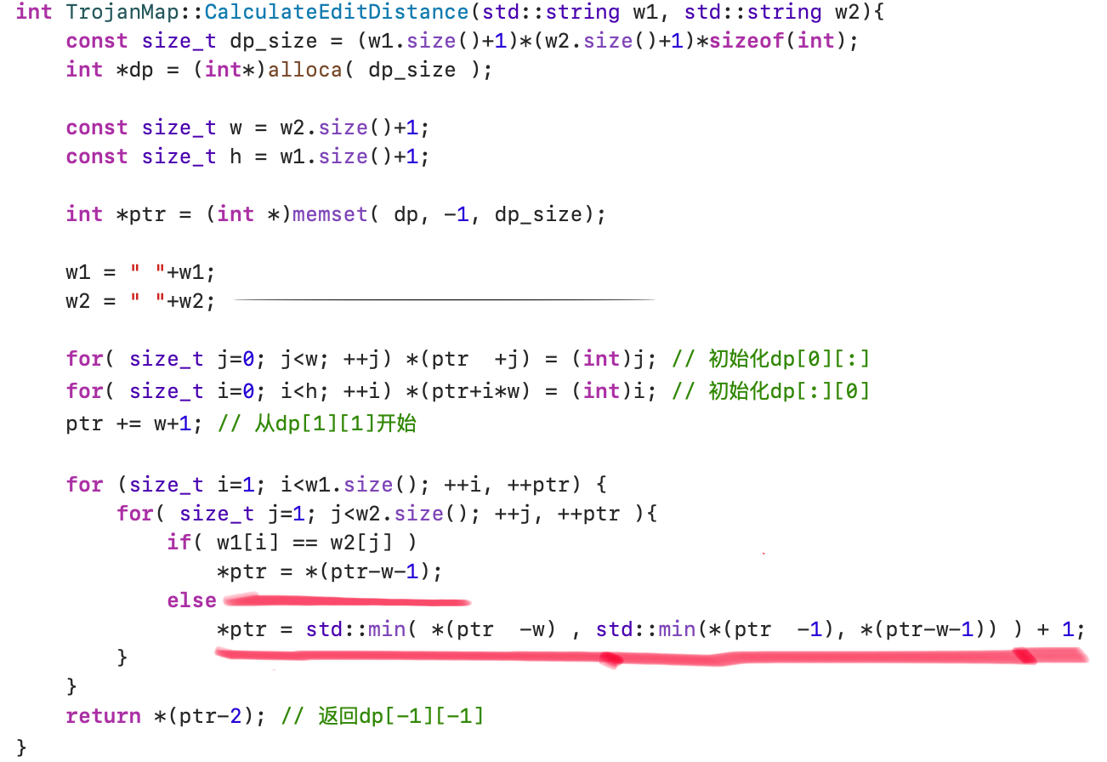
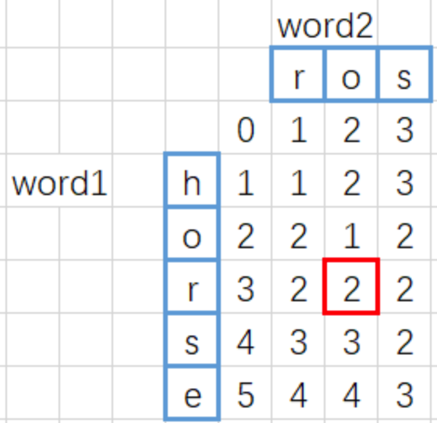
EditDistance
CalculateEditDistance(),time complexity: O(n²)
Dynamic Programming by pointer
If word1[i]==word2[j]:
D[i][j]=1+min(D[i-1][j],D[i][j-1],D[i-1][j-1]-1)
if word1[i]!=word2[j]:
D[i][j]=1+min(D[i-1][j],D[i][j-1],D[i-1][j-1])
Final edit distance

Slide 13
OUTLINE
Self-Implementation
Auto Complete Name / Closest name / Find Location
Bellman Ford Shortest Path
Dijsktra Shortest Path
Cycle Detection
Topological Sort
Travelling Salesman Problem
Find Nearby

Slide 14
BELLMAN-FORD

Slide 15
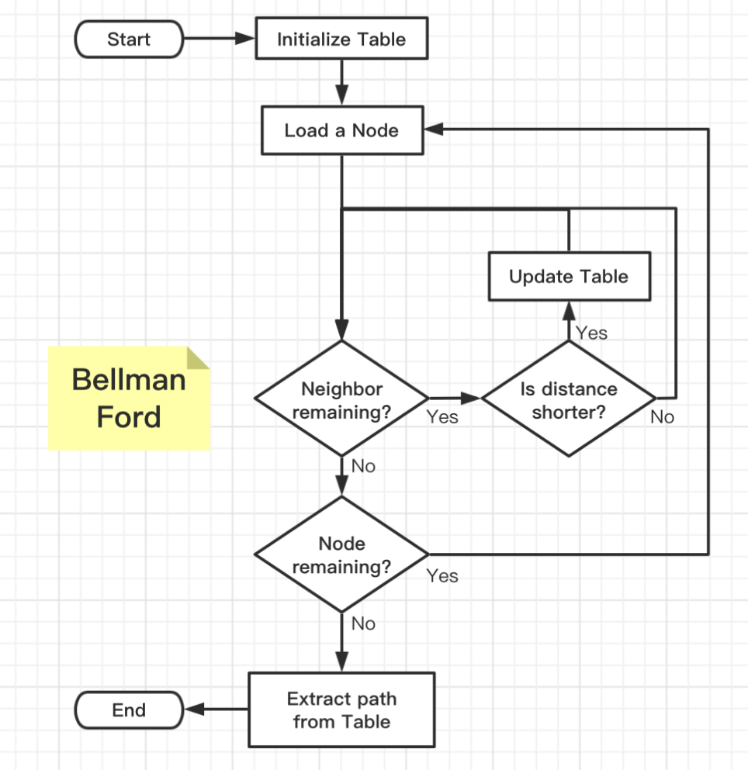

BELLMAN-FORD
What is the Table?
Good searching method
Store distance information
Store node information
How to initialize the Table?
Set all the other nodes to INFINITY
Set the start node distance to 0
Optimization
When to update the Table?
When encounter a node that distance is smaller than stored.
How to know distance is shorter?
Calculate the distance to neighbor
Add current node distance away from root
Compare to the neighbor distance
Notes:
The principle of BellmanFord Algorithm is to iterate all the nodes for each node, we relax its neighbors.
By relax, it means we compared the sum of current distance and the vary last trip from here to the neighbor to its previous record.
If it is smaller, we update the value.
One smart movement is we can stop the iteration when no element in the table was updated during the last iteration.
Just like the Covid 19 in China, if nobody in your neighborhood is positive, then you are free to go.
There is an optimization here. We can start our search from the one that being updated during the last iteration. We use queue to record that.

Slide 16
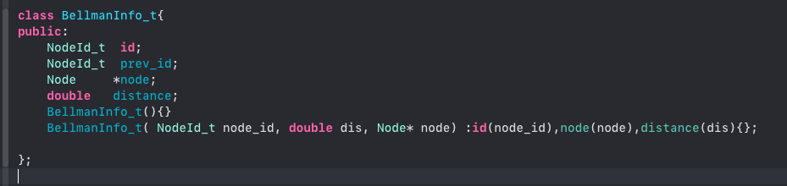
BELLMAN-FORD
Here is the data structure that used to store information for each node.
We view this as a unit stored in our table. The key combined with this unit is the id of the specific node. Therefore we use map to impliment out table.
Notes:
We view this as a unit stored in our table. The key combined with this unit is the id of the specific node. Therefore we use map to impliment out table.

Slide 17
BELLMAN-FORD
Optimization:
No need to iterate all the node
Stop when no other distance updated
Starting from the node that previously updated
How?
A data structure can store information as the order we proceed
A data structure can pop out the previous data as we go further
A data structure can perform in the way of first in first out.
We use queue!!!
When update a node, put it into the queue.
When iterate a node, pop one from the queue.
The queue always store the data that is updated from the previous iteration.
When the queue is empty, we stop. Because no additional node is updated.

Slide 18
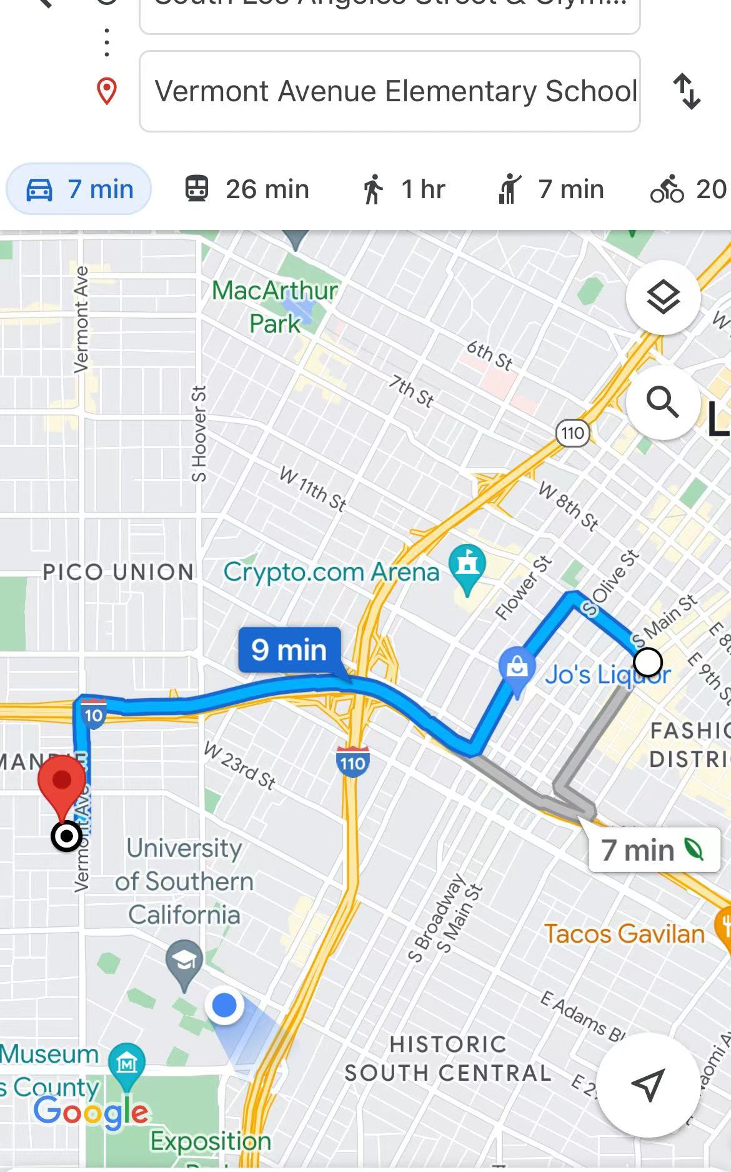
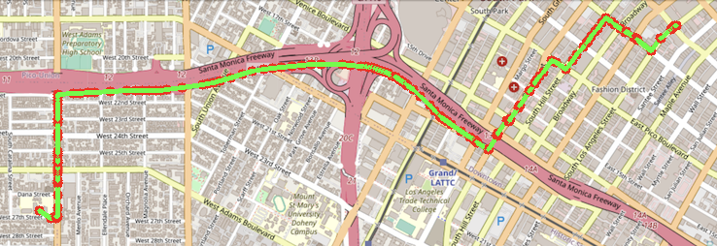
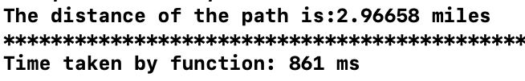
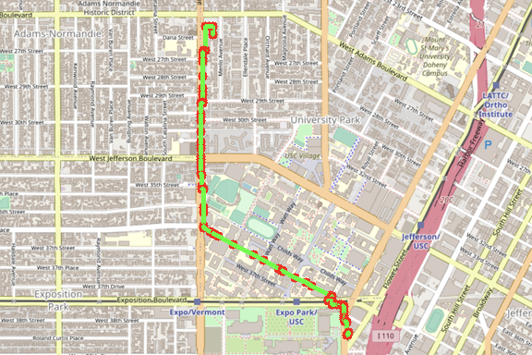
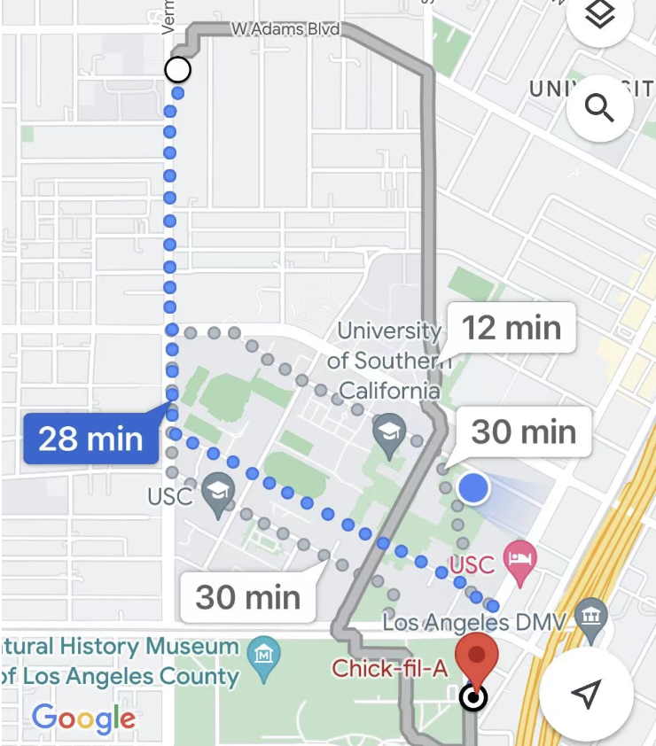
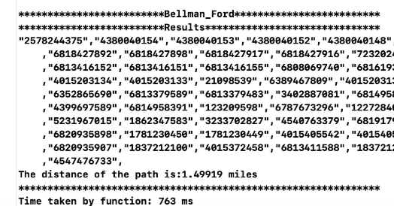
BELLMAN-FORD
Here are some results for Bellman-Ford algorithm.
Time: O(VE)
Start location:
’Los Angeles & Olympic’
Destination:
‘Vermont Elementary School’
Start location: ’Ralphs’
Destination: ‘Chick-fil-A’
Notes:
The time complexity of this algorithm is O(VE)

Slide 19
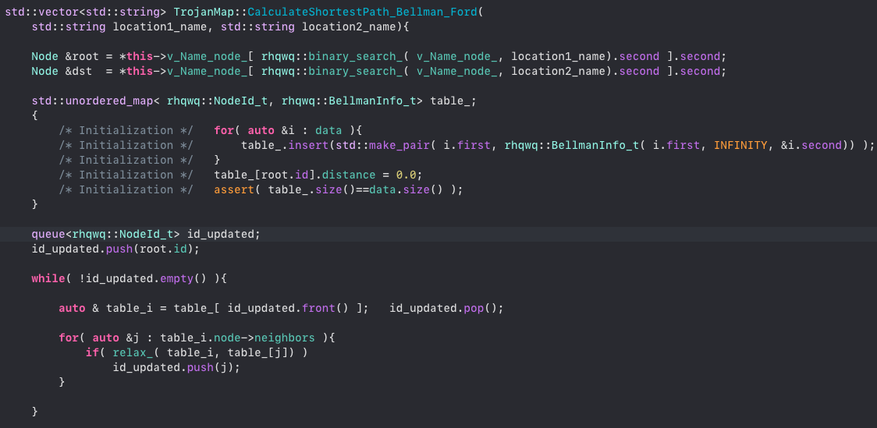
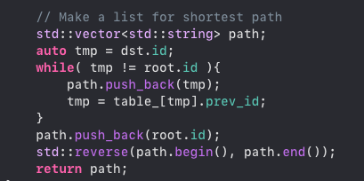
BELLMAN-FORD

Slide 20
OUTLINE
Self-Implementation
Auto Complete Name / Closest name / Find Location
Bellman Ford Shortest Path
Dijsktra Shortest Path
Cycle Detection
Topological Sort
Travelling Salesman Problem
Find Nearby

Slide 21
DIJKSTRA

Slide 22
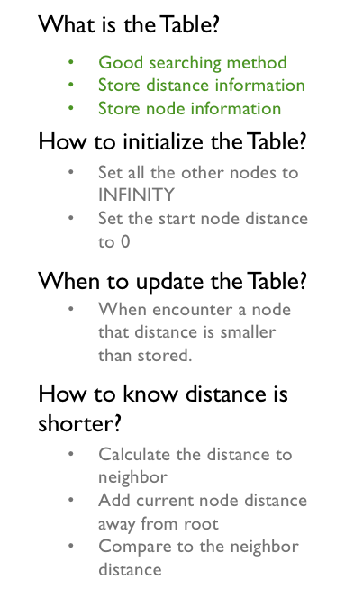
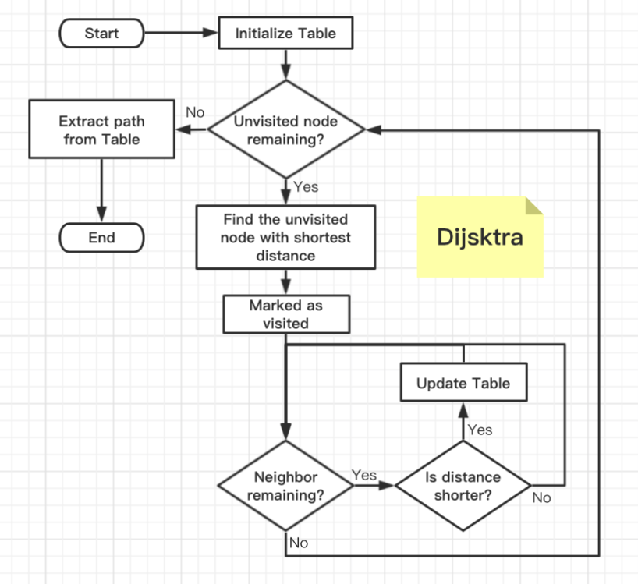
DIJKSTRA
Similar with Bellman Ford
How to find the unvisited node with shortest distance?
Use priority queue!!!
Notes:
Mostly are the same as the Bellman Ford.
But we need to mark each node either it is visited or not.
And we searched the node starting from the node of the current visited node set that had the shortest distance.
How to find that node? Use priority queue.

Slide 23
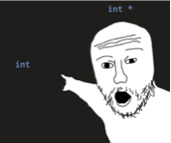
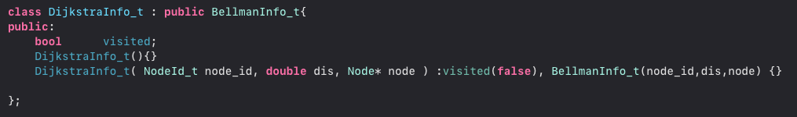
DIJKSTRA
Here is the data structure that used to store information for each node.
Simply inherit from Bellman-Ford
We need a boolean flag to mark visited node.
Again, we view this as a unit stored in our table. The key combined with this unit is the id of the specific node. Therefore we use map to impliment out table.
Notes:
Basically they are the same. We just inherited from that BellmanFord data structure.

Slide 24
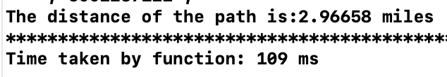
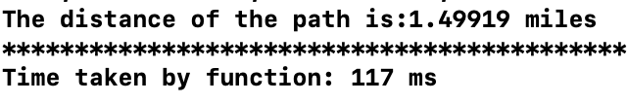
DIJKSTRA
Here are some results for Dijkstra algorithm.
Time: O((V+E)log V)
Start location:
’Los Angeles & Olympic’
Destination:
‘Vermont Elementary School’
Start location: ’Ralphs’
Destination: ‘Chick-fil-A’
Notes:
As you can see, the Dijsktra proform pretty well. Compare to the Bellman-Ford, you can the time difference.

Slide 25
BELLMAN-FORD
Here are some results for Bellman-Ford algorithm.
Time: O(VE)
Start location:
’Los Angeles & Olympic’
Destination:
‘Vermont Elementary School’
Start location: ’Ralphs’
Destination: ‘Chick-fil-A’

Slide 26
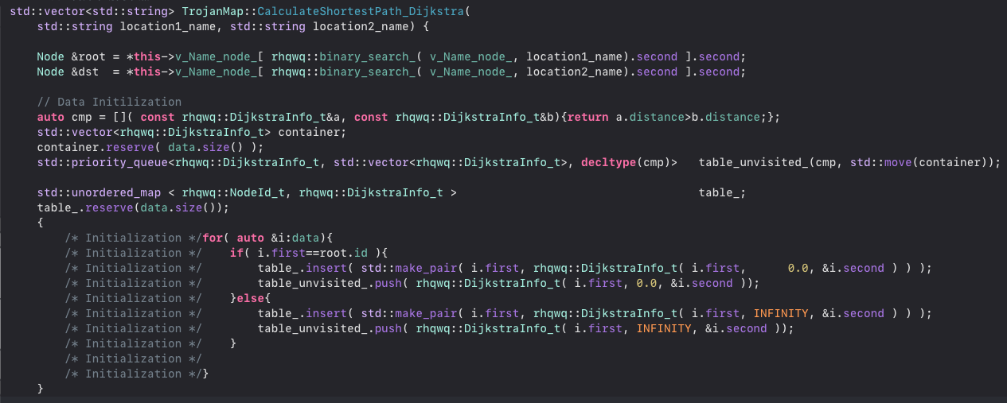
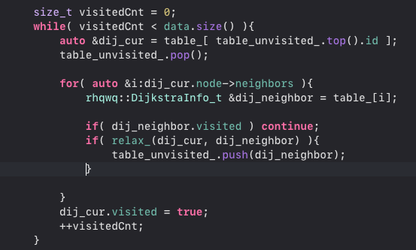
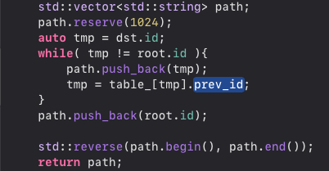
DIJKSTRA

Slide 27
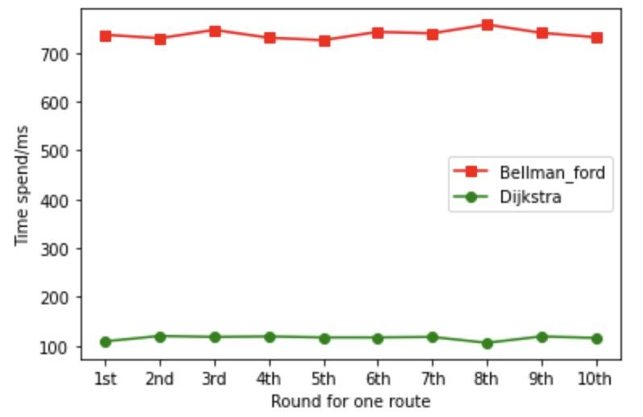
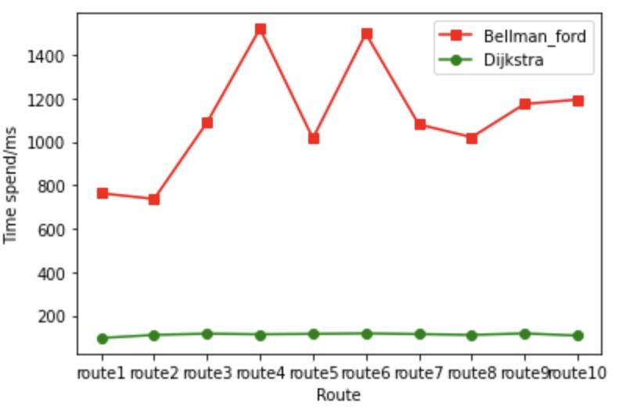
Comparison for Dijkstra and Bellman_Ford
Time spend for 1 route
Time spend for 10 routes
Dijkstra always has a better performance than Bellman Ford

Slide 28
OUTLINE
Self-Implementation
Auto Complete Name / Closest name / Find Location
Bellman Ford Shortest Path
Dijsktra Shortest Path
Cycle Detection
Topological Sort
Travelling Salesman Problem
Find Nearby

Slide 29
Cycle
Detection

Slide 30
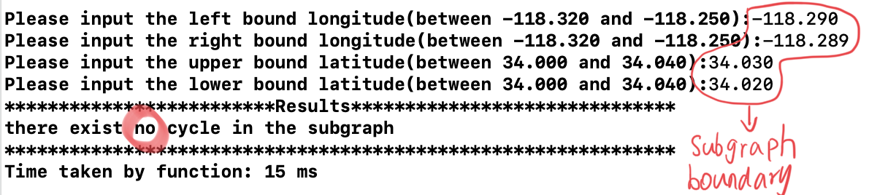
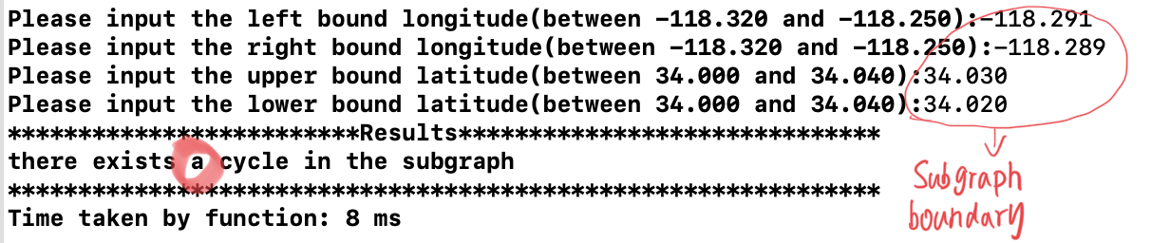
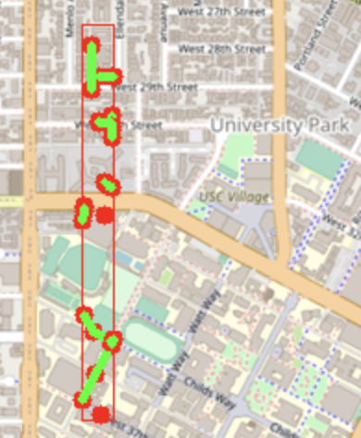
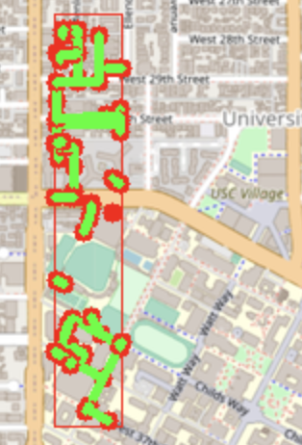
Cycle Detection
Time: O(n)
Check the existence for a cycle path in a subgraph
Use DFS to traverse all the nodes and return true if a neighbour has been visited twice (except parents) AKA back edges!!!
Green line is the edge for the neighbors
A cycle detected!
No cycle

Slide 31
OUTLINE
Self-Implementation
Auto Complete Name / Closest name / Find Location
Bellman Ford Shortest Path
Dijsktra Shortest Path
Cycle Detection
Topological Sort
Travelling Salesman Problem
Find Nearby

Slide 32
Topological
Sort

Slide 33
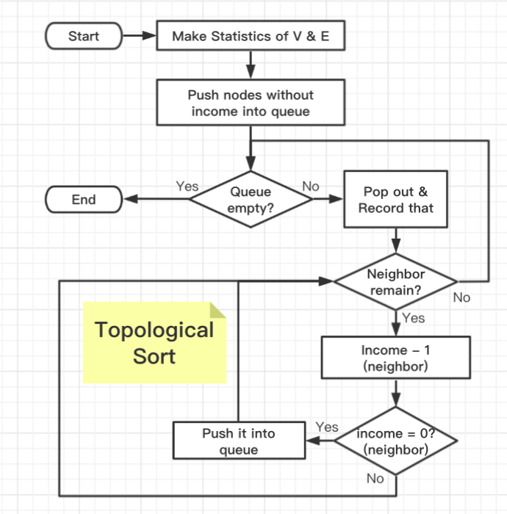
TOPOLOGICAL SORT
Why Queue ?
Breath First Search the graph
First in first out
Why Table ?
Find its node information quickly
Optimization
Push the node into queue while doing the process
Reduce neighbor’s income is the only fact cause it to zero.
Check
If the result number doesn’t match with number of nodes, there exists loop.
Optimization

Slide 34
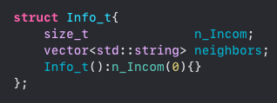
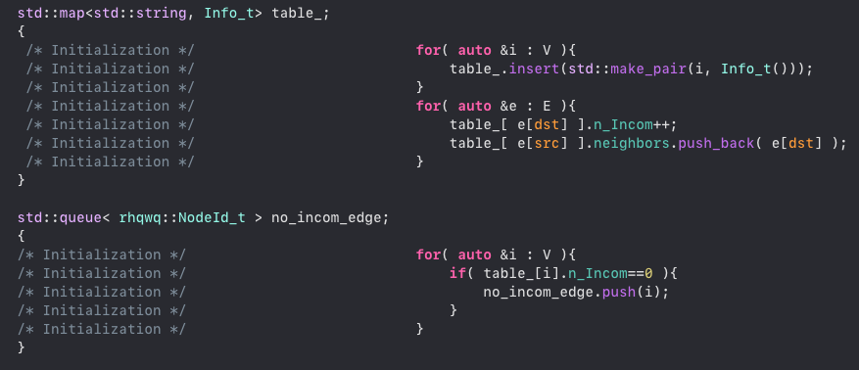
TOPOLOGICAL SORT
Initialization
Translate V and E.
Package (encapsulation)
Summarize things we need for each node

Slide 35
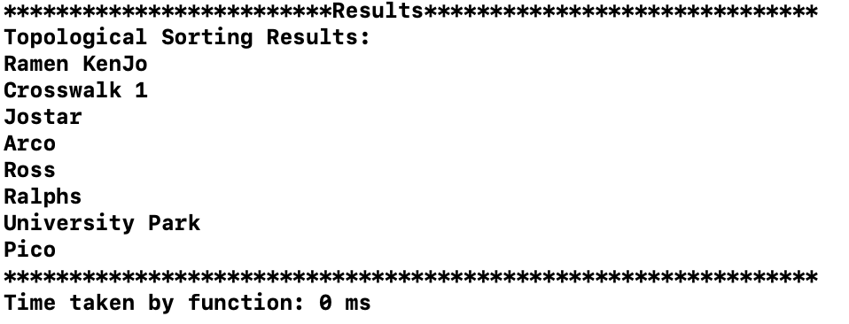
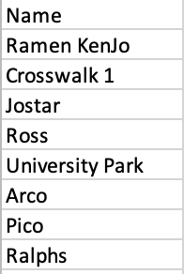
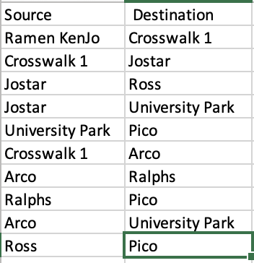
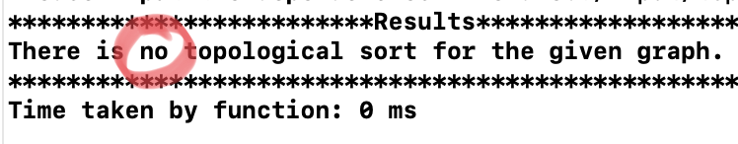
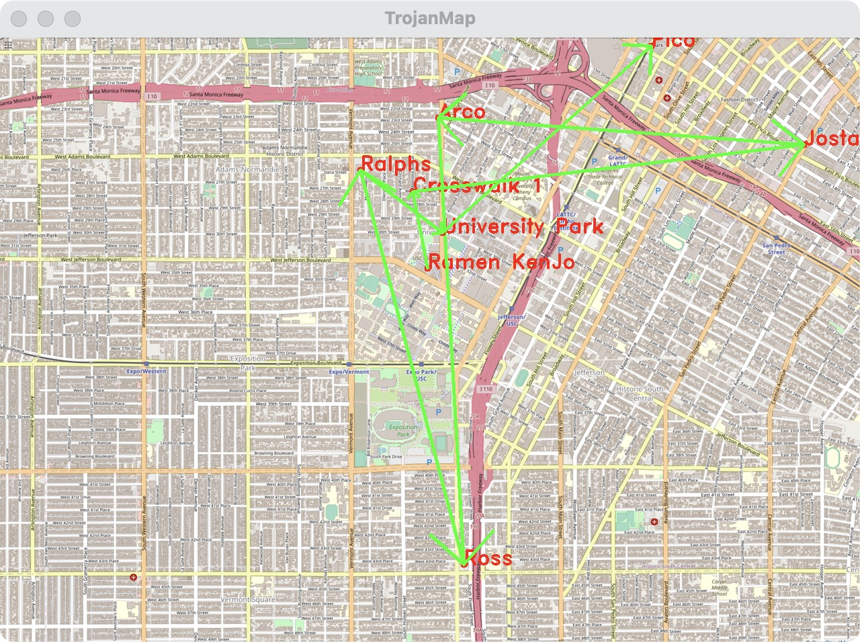
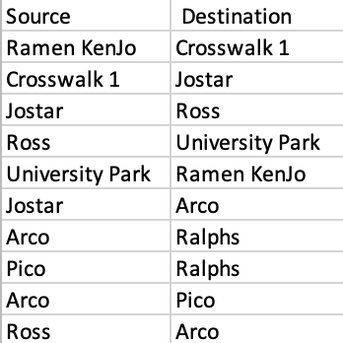

TOPOLOGICAL SORT
Here are some results for Topological Sort.
Time: O(VE)
There is a loop in these nodes

Slide 36
OUTLINE
Self-Implementation
Auto Complete Name / Closest name / Find Location
Bellman Ford Shortest Path
Dijsktra Shortest Path
Cycle Detection
Topological Sort
Travelling Salesman Problem
Find Nearby

Slide 37
TRAVELLING SALESMAN

Slide 38
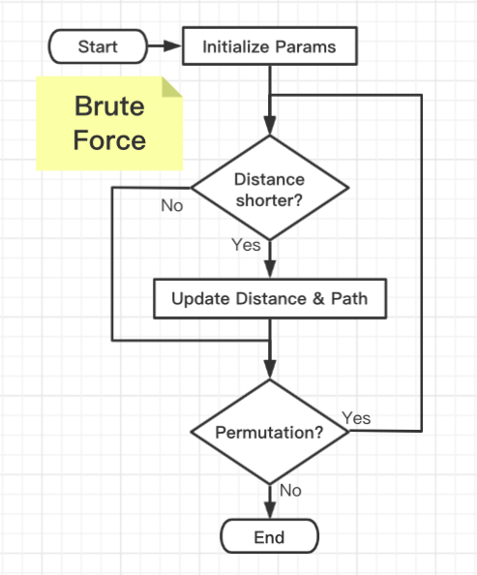

TRAVELLING SALESMAN
Method 1: Brute Force Algorithm
Permutate all the nodes
Calculate the shortest distance
C++ Template
Use vector as its container
Object will be modified and restore at the end
Much faster
Main Steps
Extract the first item as start point
Calculate all the shortest distance
Stop distance calculation when result exceeded the minimum one.

Slide 39


TRAVELLING SALESMAN
Method 2: 2-OPT
Similar with Brute Force but no permutations
No need to store all distance from end to end
Calculate the “shortest ?” distance
C++ Template
Use goto to do the loop consistently unless there is no improvement for next reverse
Main Steps
Two for loops to obtain sub part in a location
Reverse 2 edges between 2 nodes if the distance is smaller than the previous one

Slide 40

TRAVELLING SALESMAN
Method 3: Back Tracking + DP
Permutate all the nodes
Store the distance of previous path
Store all distance from end to end
Calculate the shortest distance
Try this, it’s also fast !!!
Our Permutation Template
When not reach the end, move the pivot (aka. cs ) to the next.
Swap the element you choose with the pivot one.
When reach the end, do something
Why not std::next_permutation ?
We need to do something during the process of creating a permutation.
Early backtracking to accelerate the speed.
Notes:
The principle of backtracking is DFS. But there are a lot of optimizations.
The reason we don’t use the std function is we need to do something during the process of creating a permutation.
We want to early backtracking to accelerate the speed.

Slide 41
TRAVELLING SALESMAN
Our Permutation Template
Repeat the process recursively
Repeat the process recursively
Repeat the process recursively
Notes:
Take a look at our permutation template.
Select the first element, repeat the process.
And then []
Choose another element as our first selected element by simply using swap operation.
[]
And then back to the previous order.

Slide 42



TRAVELLING SALESMAN
Method 3: Back Tracking + DP
Permutate all the nodes
Store the distance of previous path
Store all distance from end to end
Calculate the shortest distance
Recursive Function
Index mapping table.
Current best result
Distance table
Pivot
Current path solution
Our Permutation Template
When not reach the end, move the pivot (aka. cs ) to the next.
Swap the element you choose with the pivot one.
When reach the end, do something
Why not std::next_permutation ?
We need to do something during the process of creating a permutation.
Early backtracking to accelerate the speed.
Notes:
The other optimization is to use dynamic programming.
Calculate distance are very costing since it use a lot of floating number computation. Our goal is to avoid duplicated computation.
First, we memorize all the possible distance calculation by creating table to record that. The time complexity is O(n^2). But we only need to make a strictly up triangular matrix.
Second, memorize the distance of the previous path so that we don’t need to calculate it from the vary beginning.
Third, stop early. When we found that current path has already exceed the minimum one that recorded, stop.

Slide 43


TRAVELLING SALESMAN
Notes:
Apply our permutation model.
Notice that we swap the elements during the process, how to find out the distance from the table by using its index?
We create another array to synchronize the index. Therefore in the recursive function, we swap the index array as well.

Slide 44




TRAVELLING SALESMAN
RESULTS&COMPARISONS
Brute Force Time: O(n!)
Backtracking Time: O(n!) better than Brute Force
2-Opt Time(n^2 * MAX_COUNT)
Early Backtracking perform well in small #Nodes
2-Opt is the only method can give us results in these three in large #Nodes in a reasonable time (Close to the closest path)

Slide 45
OUTLINE
Self-Implementation
Auto Complete Name / Closest name / Find Location
Bellman Ford Shortest Path
Dijsktra Shortest Path
Cycle Detection
Topological Sort
Travelling Salesman Problem
Find Nearby

Slide 46
FIND NEARBY LOCATION

Slide 47

FIND NEARBY
Collect Information
Find out all the nodes with the given attributes
Use count method in std:: set
Binary Search
Sort the useful data
Search right position to insert
Export Data
Pop out the kth data from the container

Slide 48




FIND NEARBY
Time: O(n)
Here is the result for Topological Sort.

Slide 49


ANIMATION

Slide 50

FIND NEARBY

Slide 51
Thank You!

